Slide 1

BSA Football Research
Fall 2024

Slide 2
Research Question
What are the best strategies defensive play callers can use to maximize defensive EPA during “clutch time”?
How can we predict EPA in a single play based on a given scenario?
How can we predict what the offense will do?
How can we account for the past 58 minutes of the game when making our predictions?
How can we account for variability in the quality and playstyles of opposing QBs?

Slide 3
What is “clutch time”?
We are defining “clutch time” as situations where:
Two minute drill (exactly 120 seconds remaining in the game)
The point differential is less than or equal to 8 points
What is EPA (Expected Points Added)?
Expected points (EP) is the average number of points yielded at the end of the drive based on field position, down, and distance,
After the play, EPA = new EP - old EPA
Eg: On their own 35, the EP from drive roughly 0.5 points, but on the opponent’s 35 EP is roughly 2.5 points. If a play starts at the own 35 and gains 30 yards, EPA = 2.5 - 0.5 = 2

Slide 4
Data
Dataset #1: nflverse play by play
This contains formation data, pressure, coverage-type
Focus on 2018-2023 → rule changes created different play styles
Dataset #2: nflverse comprehensive data
This contains data for each game, 1999-2024
Contains required EPA data, timestamps within games (372 columns)

Slide 5
XGBoost Model Background
This regression model predicts passing EPA against all coverages given a situation and route targeted.
Used XGBoost because it efficiently handles complex data and reduces potential complications.
Selected several features to represent a specific potential scenario in a play.
Uses datasets 1 and 2, mostly 1 due to coverage data
  Only uses plays during clutch time
It evaluates a given play in a vacuum and does not account for the previous 58 minutes of the game.

Slide 6
XGBoost Model Features
Situational | Defensive Properties | Offensive Properties
Points down by (0-8) | Number of defenders in box | Pass length (short/long)
Down | Number of pass rushers | Pass location (left, middle, right)
Distance to 1st down | Time to throw | Did play go out of bounds?
Yardline | Was QB pressured? | No huddle?
Timeouts left | Coverage played | Route targeted
Seconds remaining (0-120)

Slide 7
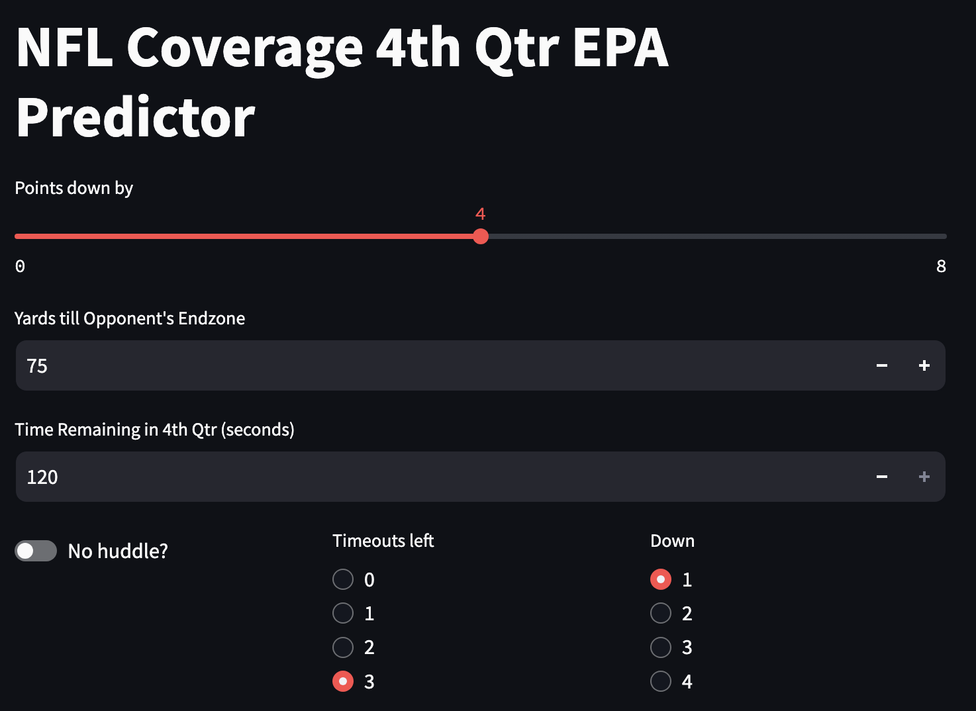
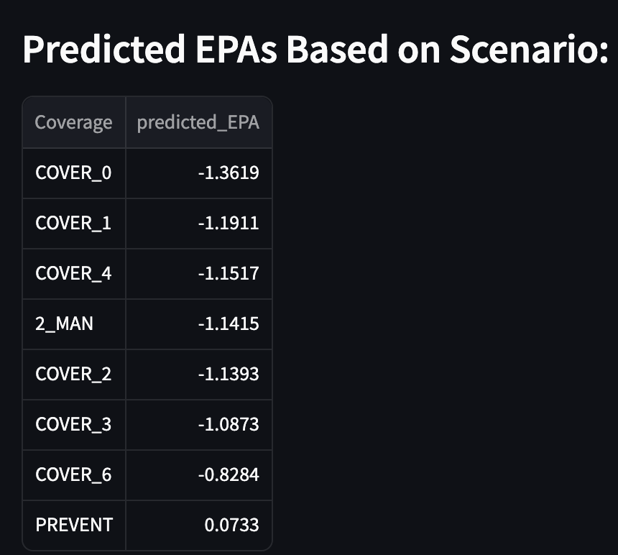
XGBoost Model App
One can input a scenario to the model using this web app constructed with Streamlit

Slide 8
XGBoost Model Evaluation
Model Metric Evaluation:
Mean Absolute Error (MAE): 0.782
Mean Squared Error (MSE): 1.472
Root Mean Squared Error (RMSE): 1.213
R-squared (R²): 0.207
Baseline Metric Evaluation:
 | Mean Baseline | Median Baseline
Mean Absolute Error (MAE) | 1.885 | 1.908
Mean Squared Error (MSE) | 0.904 | 0.892
R-Squared (R²) | 0.0 | -0.012

Slide 9
Bayesian Route Classifier
Goal
Use play by play data (via Next Gen Stats) to classify the route concept of individual plays prior to the snap
Trained on a random subset of the data from 2018-2023
Final Method
Used a naive Bayes classifier for multiclass prediction
Chosen over more complex and tree-based models due to model simplicity and interpretability
  Accuracy gains were marginal in comparison to changes in these factors (despite assumption of feature independence)

Slide 10
Bayesian Route Classifier
Model Results
Accuracy of 0.3817 on testing data
No Information Rate: 0.1613
P value (Accuracy > NIR): < 2.2e-16
Most Important Predictors (in order of importance)
Team of possession
Defensive personnel
Defensive coverage
Offensive formation
Offensive personnel

Slide 11
Bayesian Network (Joint Probability)
Advantages
  Computationally resourceful
  Versatile
  Reliable
Goal
Split by scenarios
Find weights of regressors
Run predictions

Slide 12
Bayesian Network (Joint Probability)
Results
  MLE
  MAE
    Normalization
  MSE
  R^2 (Unreliable)
  STDEV and MEAN
Features
  Play type
  Time (seconds)
  WP
  Down and distance

Slide 13
QB Clustering
Goals of clustering
  reduce complexity
  wanted to account for QB quality, playing style, mobility
Features used
  Style: Attempts/game, Aggressiveness%, Time to throw, intended air yards/attempt
  Mobility: Rushing Y/A, Y/G, TD/G, A/G
  Quality: QBR
Methodology
  Scaled Data, removed outliers
  kMeans clustering w/ elbow technique to select # of clusters

Slide 14
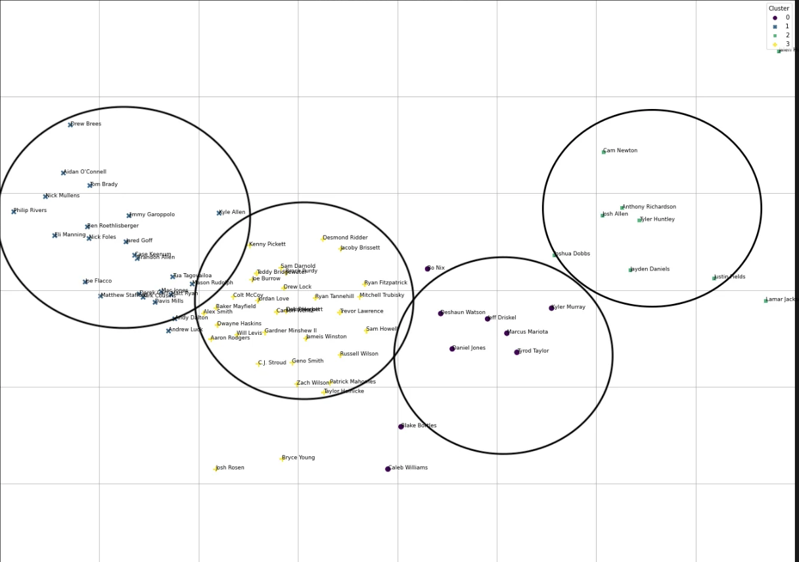
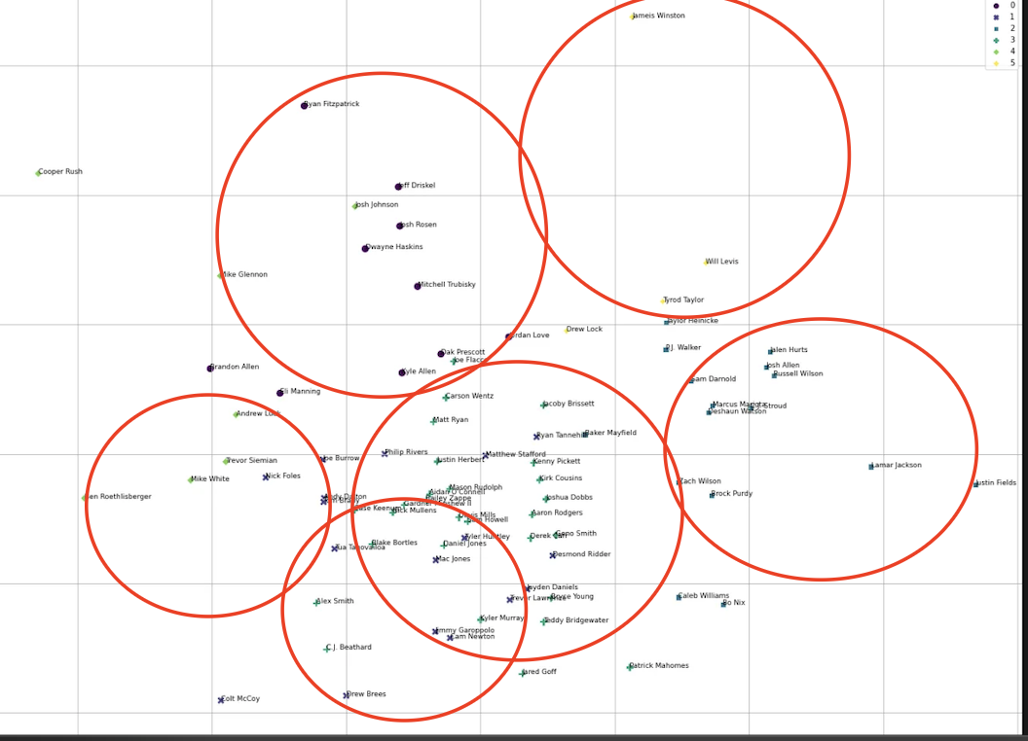
QB Clustering (cont.)
Add visualizations and examples of classes
PCA for visualization
Style
Mobility
Ended w/ 6 style clusters (could be reduced) (ex: Gunslingers, Quick short passers, dual-threat playmakers)
4 mobility clusters (could be reduced) (ex: scramblers, not mobile, low-usage vs high-usage dual-threats)

Slide 15
Challenges
Data limitations → the play by play data lacked sufficient route concept logs
Toughness of predicting certain routes due to their lack of usage during crunch time
  This anyways makes its unpredictability not a significant challenge
Issues with using time series data

Slide 16
Future Plans
Merging all our solutions to these subproblems to solve the overarching question
Create singular deliverable based on merged models where users can input a scenario to get predictions
Accounting for QB’s passing location tendencies, time to throw, difficulty to pressure, and quality via QBR
Using QB Clustering to improve accuracy of route classification and EPA predictions
Consider clustering defensive tendencies

